Slide 1
Dichroic prism in solar panel
jfdlljsljddddddfdisisfd

Slide 2
Content
Solar energy contribution .
Basic working of solar panel
What is dichroic prism.
Buckets of energy

Slide 3
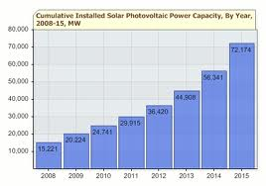
Solar energy contribution

Slide 4
Basic working of solar cell

Slide 5
Efficiency of solar panel
Normally efficiency of solar
panel is 17%.
But these is not enough……………….

Slide 6
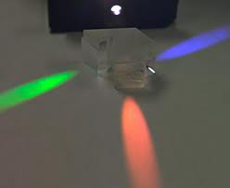
What is Dichroic prism
Prism which splits light into
beam of red, green, blue color
wavelength.

Slide 7
Way followed by KIRKPATRICK for 32% efficiency

Slide 8
Color with different energy
COLOR | WAVELENGTH | ENERGY
RED | 650-750nm | less
GREEN | 495-570nm | medium
BLUE | 459-495nm | high

Slide 9
Absorbing different wavelength energy
ENERGY OF PHOTON | Doping material
Low energy | Germanium
Medium energy | Gallium arsenide
High energy | Indium gallium phosphide

Slide 10
Advantages of Dichroic prism
Minimum light absorption, most of the light is directed to one of the output beams.
Better color separation than with most other filters
Easy to fabricate for any combination of pass bands.

