Slide 1
Super Conductivity
By-
Niharika Manmode
MANIT , Bhopal
nika.made.001@gmail.com

Slide 2
Acknowledgement
First of all I would like to thank Mr. Anil Vanalkar for giving me this opportunity to present papers on this highly potential topic of superconductivity. I would also like to thank my teacher Mr. Ramesh for giving me information on this topic.
Also I would like to thank my friends for their creative ideas.
Finally I would like to thank my parents for being very supportive.

Slide 3
SuperConductivity
It is the property of complete disappearance of electrical
resistance in solids when they are cooled below a
characteristic temperature. This temperature is called
transition temperature or critical temperature.

Slide 4
Superconductive state of mercury (TC=4.15 K) was
discovered by the Dutch physicist Heike Kamerlingh
Onnes in 1911, several years after the discovery of
liquid helium.

Slide 5
Superconducting materials exhibit the following unusual behaviors:
1. Zero resistance - Below a material’s Tc, the DC electrical resistivity is really zero, not just very small. This leads to the possibility of a related effect.
2. Persistent currents - If a current is set up in a superconductor with multiply connected topology, e.g. a torus,
it will flow forever without any driving voltage. (In practice experiments have been performed in which persistent currents flow for several years without signs of degrading).

Slide 6
3. Perfect diamagnetism - A superconductor expels a
weak magnetic field nearly completely from its interior
(screening currents flow to compensate the field within a
surface layer of a few 100 or 1000 A, and the field at the
sample surface drops to zero over this layer).
4. Energy gap - Most thermodynamic properties of a superconductor
are found to vary as e−/(kBT), indicating
the existence of a gap, or energy interval with no allowed
Eigen energies, in the energy spectrum. Idea: when there
is a gap, only an exponentially small number of particles
have enough thermal energy to be promoted to the available
unoccupied states above the gap. In addition, this gap
is visible in electromagnetic absorption: send in a photon
at low temperatures (strictly speaking, T = 0), and no
absorption is possible until the photon energy reaches 2

Slide 7
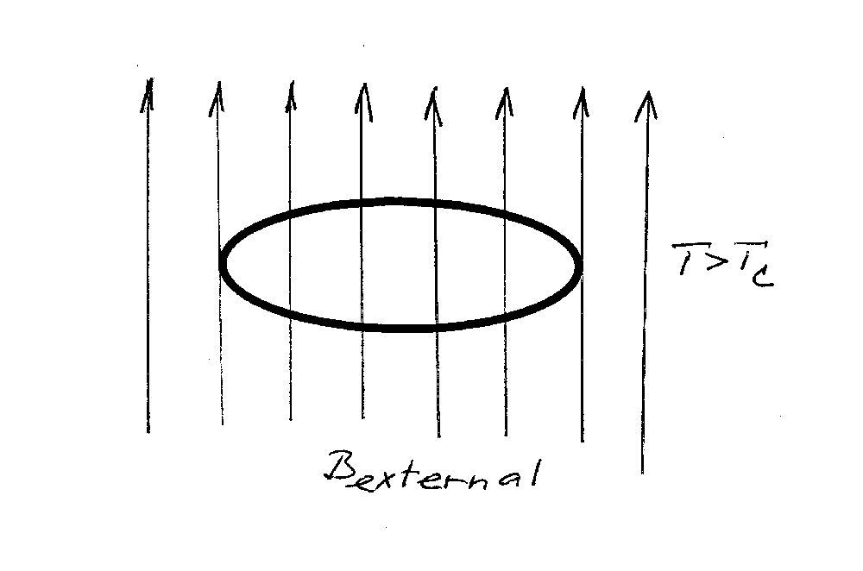
i.e. until the energy required to break a pair is available.
Effect of trapped magnetic flux
Consider a ring made out of superconductive
material.
Perform the following thought experiment:
1. At T>Tc the material is normal state. When the
external magnetic field is turned on, it penetrates
through the ring.

Slide 8
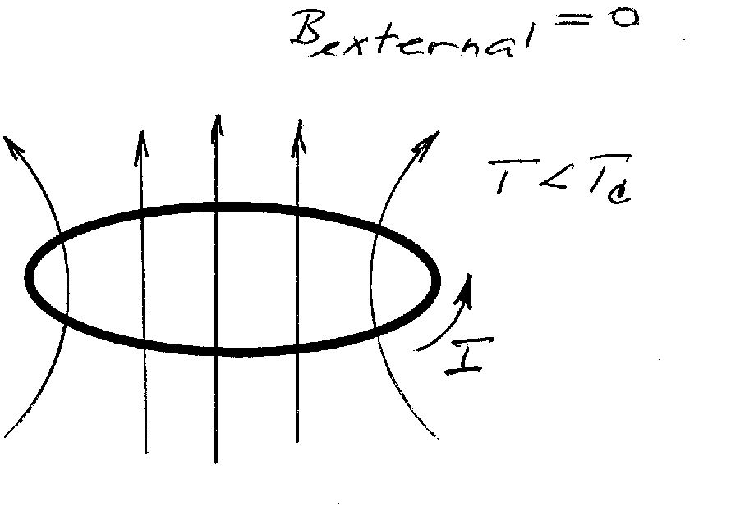
2. Reduce the temperature so that T<Tc.
3. Remove the external magnetic field.
4. You discover that the magnetic field that was
penetrating through the opening of the ring magnetic
field remains there. The magnetic flux remains
trapped in the ring opening.

Slide 9
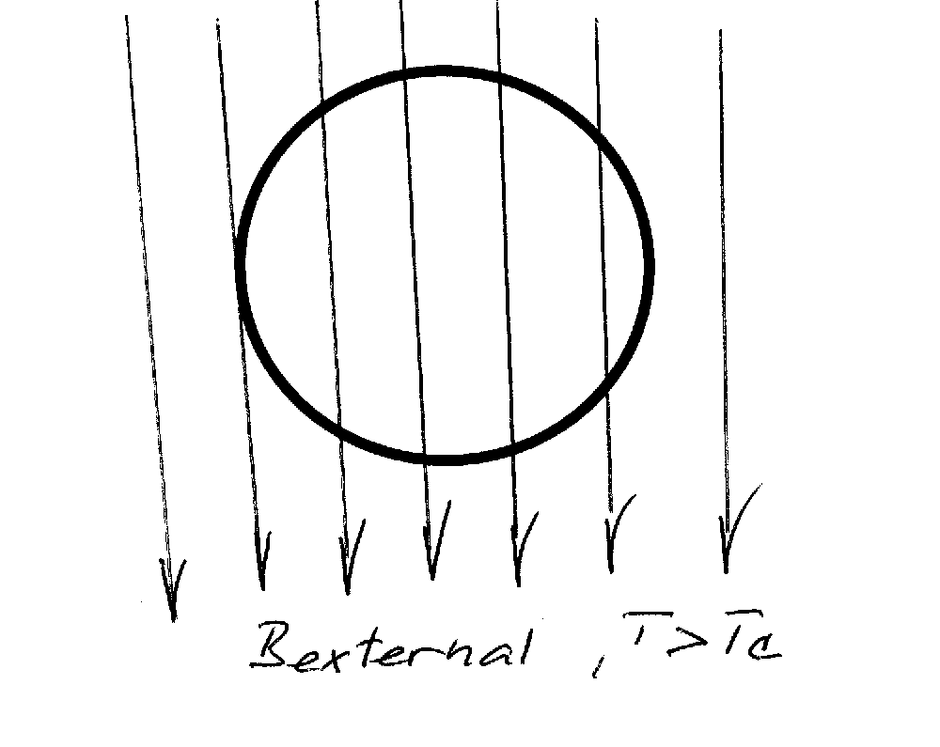
Meissner effect
expulsion of magnetic field from the interior of the superconductor
Thought experiment
Consider a sphere made out of superconductive material. At T>Tc the material is in normal state. When external magnetic field is turned on, the
external magnetic field penetrates through the material.

Slide 10
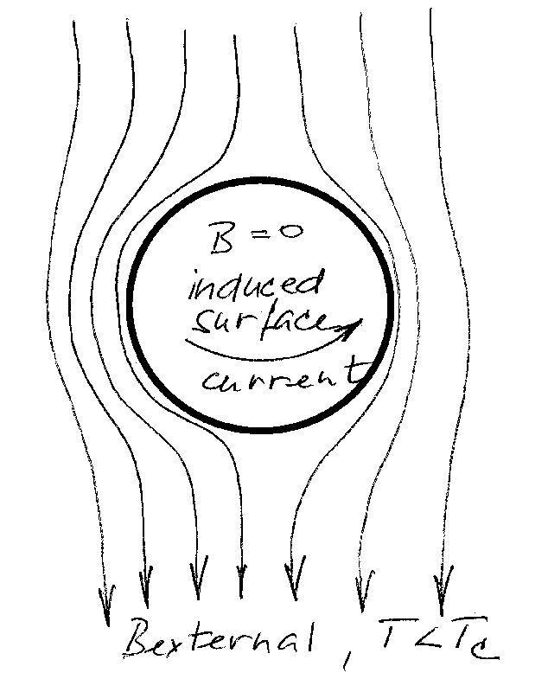
one would expect that at T<Tc the magnetic field would remain trapped in the material after the external field has been turned off.
The trapping of magnetic field does not happen (the absence of magnetic field inside the superconductor is the Meissner effect).
This is what happens:

Slide 11
The magnetic field is expelled from the interior of the superconductor, inside the superconductor B=0. Superconductor expels magnetic field from the
interior by setting up electric current at the surface. The surface current creates magnetic field that exactly cancels the external magnetic field!
This electric current at the surface of the superconductor appears at T<Tc in order that B=0 inside the superconductor.

Slide 12
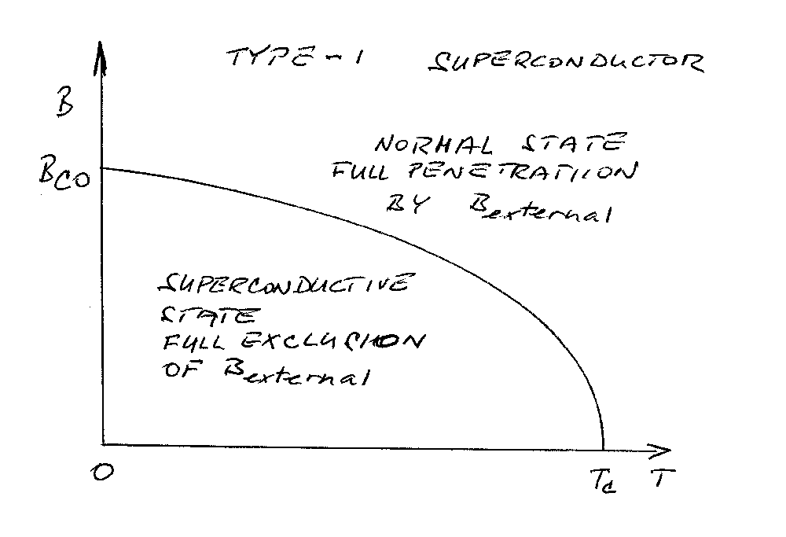
Type I and Type II Superconductors
exhibit different magnetic response to external magnetic field.
In Type I superconductor the magnetic field is completely expelled from the interior for B<BC.

Slide 13
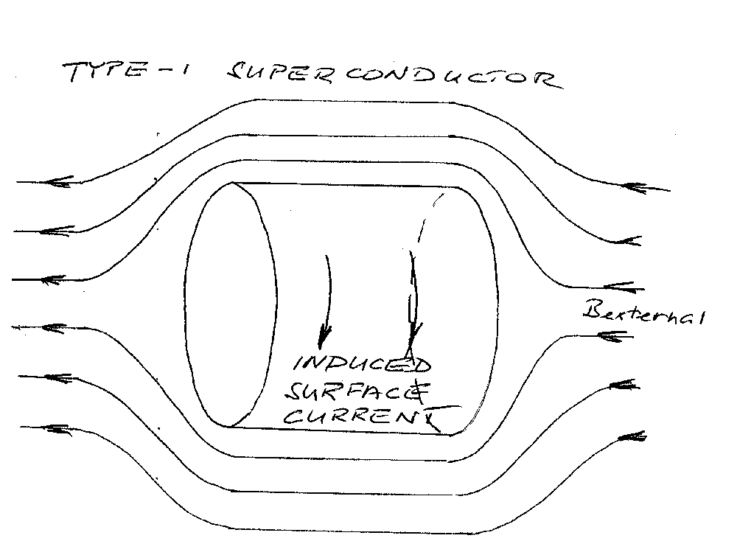
Type II superconductors have two values of critical
magnetic field, for B<BC1 the magnetic field is completely expelled (Type-I behavior), whereas for BC1<B<BC2 the magnetic field partially penetrates through the material

Slide 14
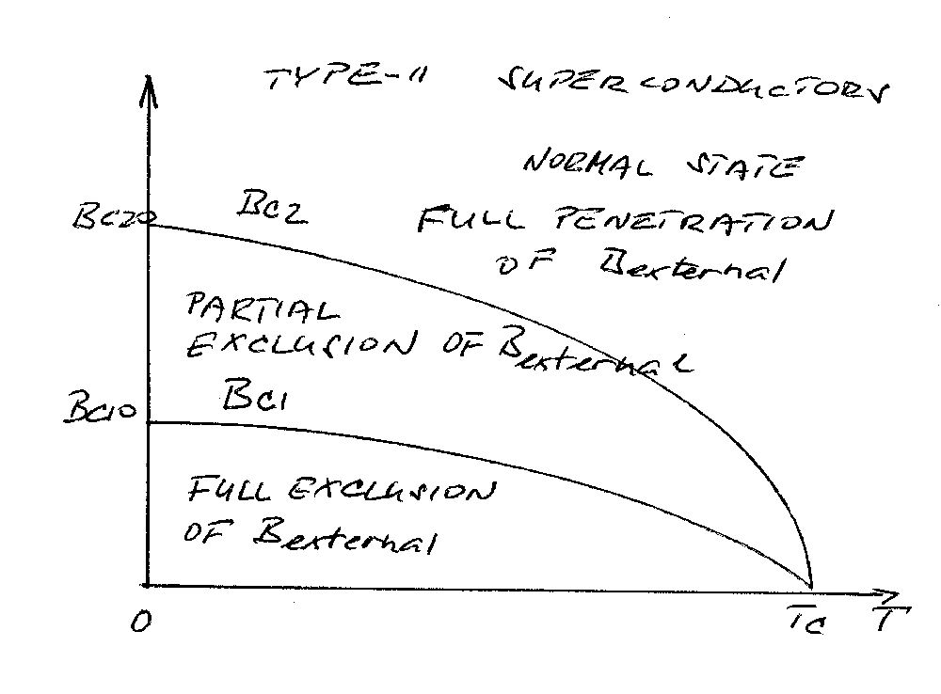
The bulk of superconductor material breaks down into two regions: superconductive from which the external field is completely expelled, and normal through which the external field penetrates.

Slide 15
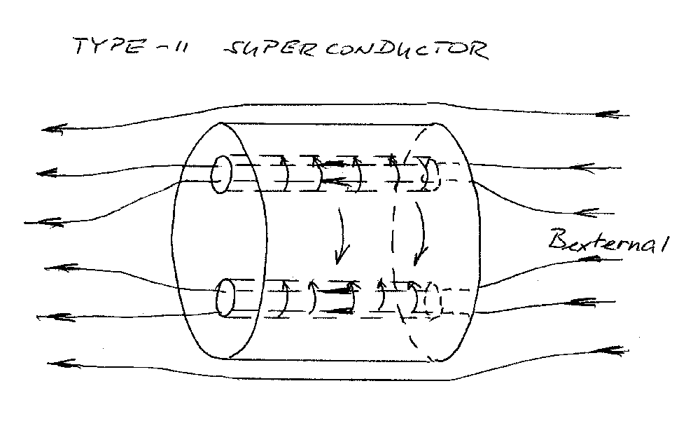
The normal regions are distributed as filaments filled with the external magnetic field. The flux of magnetic field through the filaments is quantized. Electric
current is induced at the interface between the normal and the superconductive regions, the “surface” of filaments is “wrapped” in current which
cancels the magnetic field in the superconductive regions. The electric current is carried by the superconductive regions of Type-II material.

Slide 16
Mechanism of superconductivity
Interaction between electrons and lattice atoms is critical for the existence of superconductive state. Good conductors (weak scattering from the lattice) are poor superconductors (low TC). Electrons on their flight through the lattice cause lattice deformation (electrons attract the positively charged lattice atoms and slightly displace them) which results in a trail of positively charged region. This positively charged region of lattice atoms attracts another electron and provides for electron-electron coupling.

Slide 17
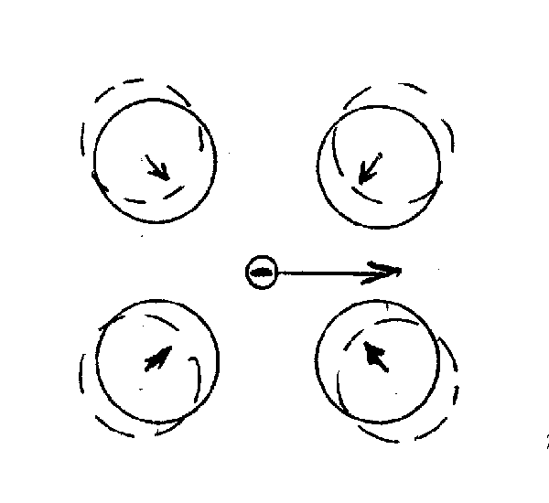
Electron pairs, and not single electrons, are charge carriers in superconductors
The electron-electron coupling is weak and can be destroyed by thermal motion of the lattice. For this reason superconductivity exists only at low temperatures.

Slide 18
The electron-electron coupling results in electron pairing - formation of Cooper pairs. The Cooper pairs do not have spin 1/2 and therefore do not follow Pauli’s principle (1 electron per state). Large number of Cooper pairs can populate one collective state. This state is stable and requires some additional energy input (thermal energy) to be destroyed. The binding energy of Cooper pairs in the collective state is several meV.
Formation of Cooper pairs is a spontaneous process resulting in lower energy state of electrons in the superconductor. In superconductors, the filled state are occupied by Coopers pairs, and the empty band, above Eg, is occupied by “broken” Cooper pairs. The band gap Eg is a measure of binding energy of Cooper pairs, the greater binding energy, the greater Tc.

Slide 19
Eg = 3.53.kBTc
Eg confirmed from absorption spectra. For hc/l>Eg
electromagnetic radiation absorbed.
“No scattering, no resistance”
The formation of collective state of Cooper pairs take place at T<TC. In the collective bound state the Cooper pairs do not scatter from the lattice and the conductivity of superconductor is infinitely large. Scattering of electrons from the lattice atoms require a change of state of electron.
In the superconductive state the current carrying species is the electron pair.

Slide 20
For the Cooper pair to scatter it would have to change its state (like an electron in normal metal). However, the Cooper pair is coupled to a large number of other Cooper pairs and so the whole collective of Cooper pairs would have to be involved in scattering at once. This does not happen, and therefore there is no scattering of Cooper pairs and therefore the conductivity is infinite.
Josephson effect
Consider two superconductors separated by a thin insulating layer, few nm thick.
Brian Josephson noted (1962) that
1. Electron pairs in the two superconductors can form a single collective state and the electron pairs can tunnel through the insulating layer.

Slide 21
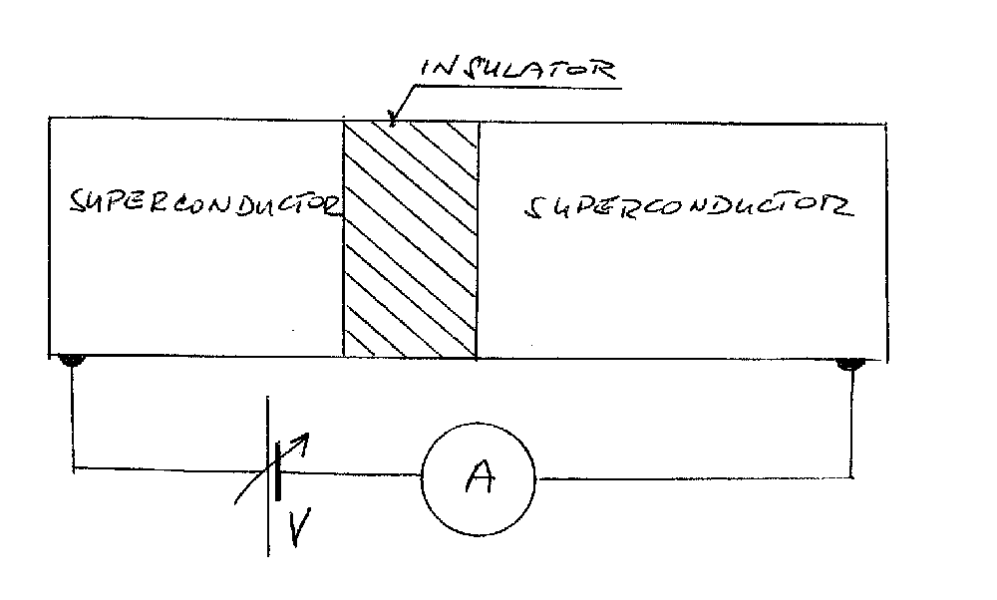
DC Josepson effect = electron tunneling curent across the junction in the absence of applied voltage.
2. If a DC voltage bias is applied across the junction, there is an AC current through the junction that oscillates with frequency

Slide 22
f = 2e/h V
The existence of ac current through the biased junction = AC Josephson effect.
The AC Josephson effect provides a method for the most accurate measurement of the electric potential difference because f can be determined accurately by “frequency counters”.
The value of 2e/h=483.6 MHz/mV.
SQUID
=Superconductive QUantum Interference Device
consist of two Josephson junctions forming a ring.

Slide 23
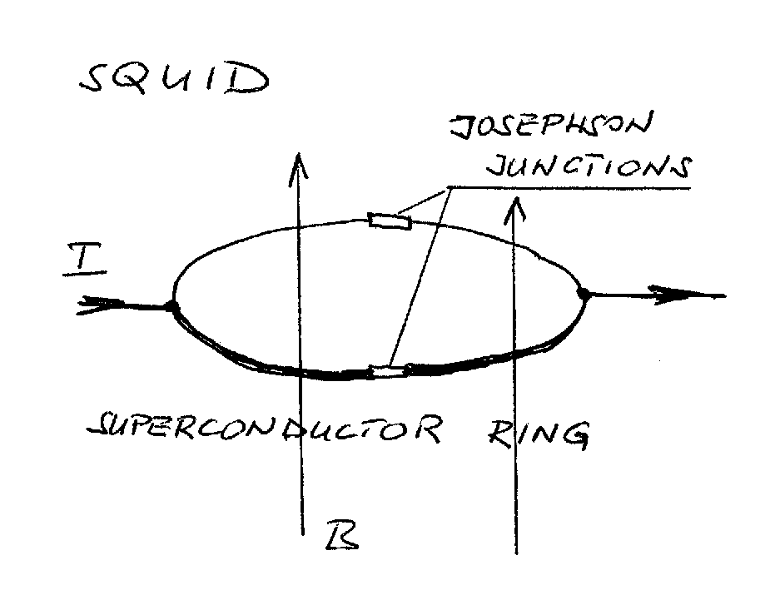
SQUIDs are used to measure extremely weak magnetic fields (for example, magnetic fields created by currents in the brain in response to various stimuli or thinking).

Slide 24
Uses of superconductors
1. Maglev (magnetic levitation) trains. These work because a superconductor repels a magnetic field so a magnet will float above a superconductor – this virtually eliminates the friction between the train and the track. However, there are safety concerns about the strong magnetic fields used as these could be a risk to human health.
2. Large hadron collider or particle accelerator. This use of superconductors was developed at the Rutherford Appleton Laboratory in Oxfordshire, UK in the 1960s. The latest and biggest large hadron collider is currently being built in Switzerland by a coalition of scientific organisations from several countries. Superconductors are used to make extremely powerful electromagnets to accelerate charged particles very fast (to near the speed of light).

Slide 25
3. SQUIDs (Superconducting QUantum Interference Devices) are used to detect even the weakest magnetic field. They are used in mine detection equipment to help in the removal of land mines.
4. The USA is developing “E-bombs”. These are devices that make use of strong, superconductor derived magnetic fields to create a fast, high-intensity electromagnetic pulse that can disable an enemy’s electronic equipment. These devices were first used in wartime in March 2003 when USA forces attacked an Iraqi broadcast facility. They can release two billion watts of energy at once.
The following uses of superconductors are under development:
-> Making electricity generation more efficient
-> Very fast computing.

Slide 26
Bibliography
- IEEE/CSC & ESAS European Superconductivity
news forum
Blue Skies Research
Internet

Slide 27
Thank You

